Slide 1
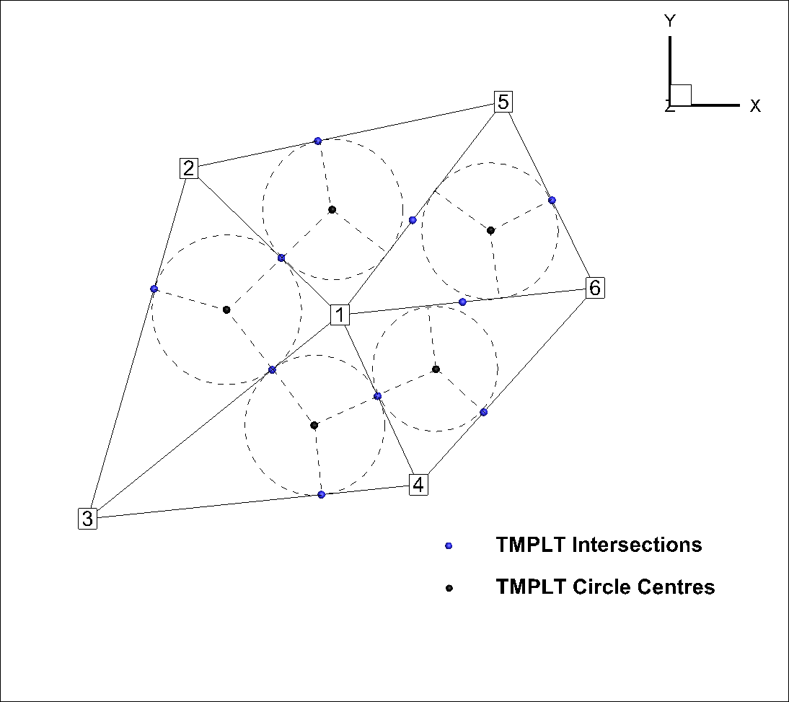
Simple Test Problem: Node-centred Tecplot Generation
Numbers shown to right are Cell numbers
Cell 1 (interior cell):
is connected to cells 2,3,4,5 and 6
horizontal area is defined by the inner circle centres for all elements of which it is a part(blue fill)
flow length to cell 2 is the distance from point 1 to intersection point A
Cell 2 (boundary cell):
is connected to cells 1,3 and 5
horizontal area is defined by the inner circle centres for all elements of which it is a part and tangent points along outer boundary (orange fill)
Cell 2 to Cell 1 flow length is distance from point 2 to intersection point A
Cell 1-2 flow area is distance from point B to point C
C
A
B

Slide 2
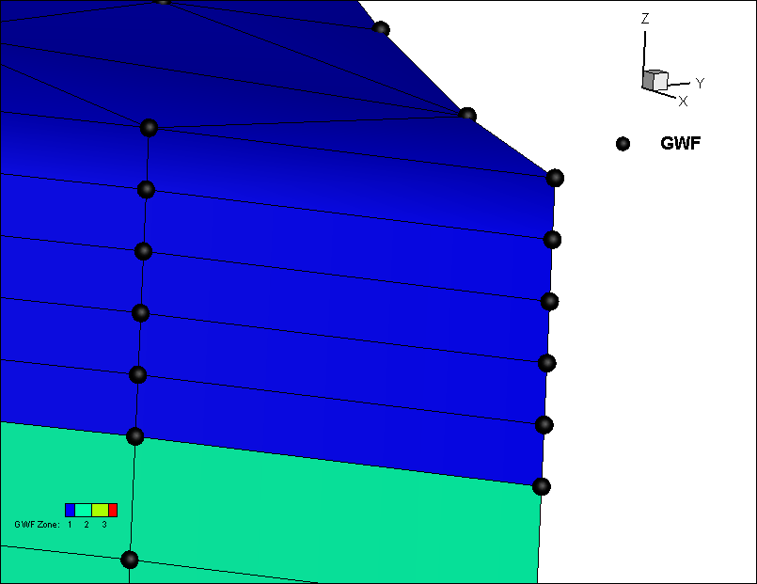
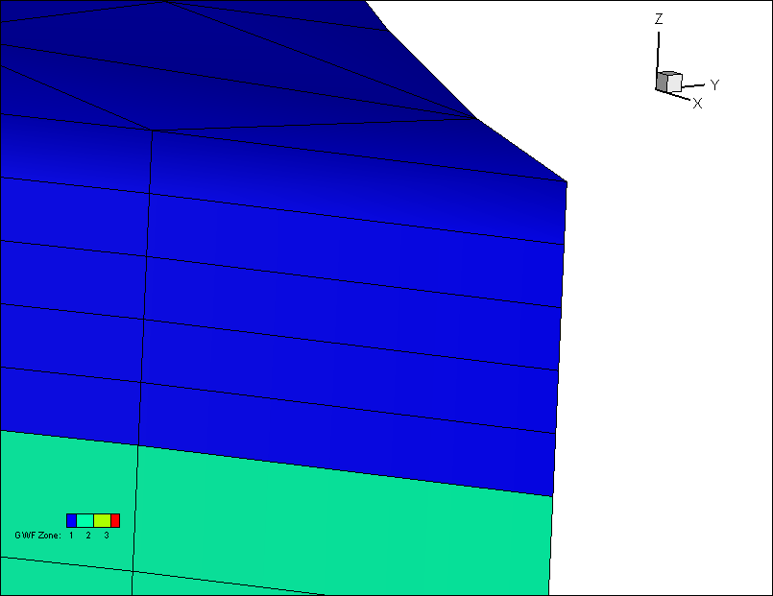
Method 1: half cell at top and bottom of domain
Can be plotted directly in Tecplot because number of cells equals number of nodes
Method 2: full cells
Layer 1
Top
Top
Layer 2
Bottom
Layer 1
Layer 2
Bottom

Slide 3
Node-Centred Modflow Cell Generation Methodology
Define the SWF and GWF domains exactly the same as in the mesh-centred approach. These are used for Tecplot visualization.
We already write the mesh-centred files correctly for Modflow
We just need to swrite a set of node-centred files with the proper IA-JA structure, cell areas, flow lengths and flow areas based on the node-to-node connections define by the node list for each element

Slide 4
Below is the code that writes the Modflow SWF file for the mesh-centred case.
For the node-centred approach, we just have to:
Change all Modflow.SWF.nCells references to Modflow.SWF.nNodes
Define IA and JA appropriately for the node-centred case
!-------------------------------------------------------------
subroutine WriteSWFFiles(Modflow)
implicit none
type (ModflowProject) Modflow
integer :: i, j, i1, i2, nEnd
write(Modflow.iSWF,'(a)') '#1. NSWFNDS NJA_SWF NSWFGWC
write(Modflow.iSWF,'(10i9)') Modflow.SWF.nCells, Modflow.SWF.njag, Modflow.SWF.nCells,…
write(Modflow.iSWF,'(a)') 'INTERNAL 1 (FREE) -1 IA()'
write(Modflow.iSWF,'(10i2)') (modflow.SWF.ia(i),i=1,modflow.SWF.nCells)
write(Modflow.iSWF,'(a)') 'INTERNAL 1 (FREE) -1 JA()'
i1=1
do i=1,modflow.SWF.nCells
i2=i1+modflow.SWF.ia(i)-1
write(Modflow.iSWF,*) (modflow.SWF.ja(j),j=i1,i2)
i1=i2+1
end do

Slide 5
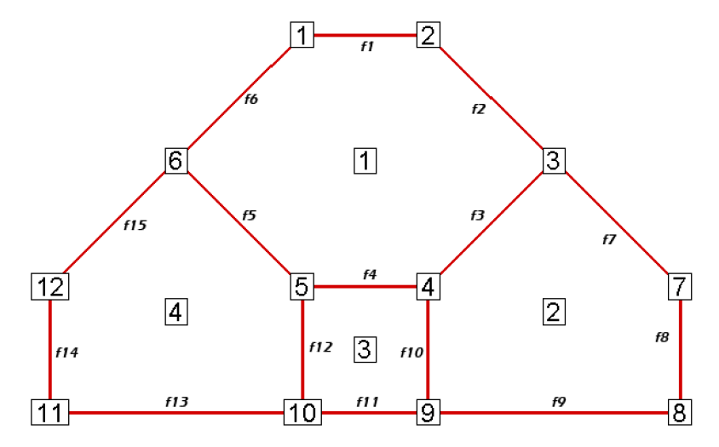
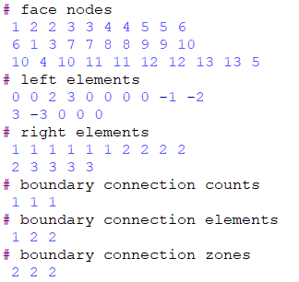
Teplot polygons are face-based, so the connectivity list has to look something like this:
For now, we’ll use simpler cell-based template and SWF meshes to define the node-centred modflow domain.

Slide 6
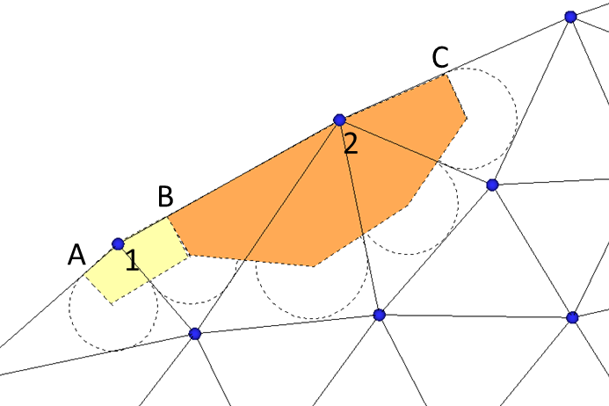
Node-centred Tecplot Representation/Generation
If we define a 2D Tecplot polygon mesh it will give us the neighbour information as before
Tecplot Polygon Element Setup
1 and 2 (original nodes in 2D mesh) define xCell, yCell coordinates
Inner circle centres (a to e) become nodes around the polygon element
New nodes (A to C) must be generated along the outer boundary for each triangular element side
Cell 1 – node list: 1, A, a, b, B
Cell 2 – node list: 2, B, b, c, d, e, C
Inner cell – node list: e.g. a, b, c, d, e, etc depending on number of connections
e
d
b
c
a

Slide 7
Node-centred Tecplot Generation Pseudocode
Flag boundary nodes
Loop over 2D mesh nodes
nCell=nCell+1
xcell(ncell)=x(2D mesh node)
ycell(ncell)=y(2D mesh node)
if(boundary node)
iNode+ = node number
iNode+= A
iNode+= B
endif
loop over elements containing node
iNode+=a
iNode+=b
etc
end loop
End loop
Sort A,B,a,b relative to xcell ycell by angle
e
d
b
c
a

